Slide 1
Digital Portfolio
STUDENT NAME: Jeevarathinam
REGISTER NO AND NMID: D3E16C508F8E4C6B62A40CC61F5B9394
DEPARTMENT: BSC INFORMATION SYSTEMS MANAGEMENT
COLLEGE: COLLEGE/ UNIVERSITY SHANMUGA INDUSTRIES ARTS AND SCIENCE COLLEGE THIRUVALLUVAR UNIVERSITY

Slide 2
PROJECT TITLE
"personal web Development portfolio: Jeevarathinam'm Journey "

Slide 3


AGENDA
Problem Statement
Project Overview
End Users
Tools and Technologies
Portfolio design and Layout
Features and Functionality
Results and Screenshots
Conclusion
Github Link
3/21/2024 Annual Review

Slide 4

PROBLEM STATEMENT
In today’s competitive job market, it's essential for developers and students to showcase their skills, experience, and projects online. Without a central platform or personal brand, it becomes challenging to present capabilities to potential employers,

Slide 5

PROJECT OVERVIEW
This project is a personal portfolio website created by Jeevarathinam to highlight their background, technical skills, and web development projects. The site is fully responsive and provides sections such as Home, About, Projects, and Contact, offering a comprehensive overview of the individual’s profile.

Slide 6

WHO ARE THE END USERS?
The primary end users of the portfolio website include: Hiring managers or recruiters looking for web development talent. College faculty or peers reviewing project work or academic progress. Clients interested in small web projects or freelance work. General visitors who want to learn more about Jeevarathinam's skills and background.

Slide 7

TOOLS AND TECHNIQUES
Interactive Projects Section: Hover effects on project cards. ✅ Contact Section: Clickable email, LinkedIn, and GitHub links. ✅ Semantic HTML: Use of appropriate tags for better SEO and accessibility.

Slide 8
POTFOLIO DESIGN AND LAYOUT
The website follows a clean and minimalistic design with the following structure: Header: Sticky navigation bar with site name and links to sections. Home: Introduction with name and a short description.
8

Slide 9
FEATURES AND FUNCTIONALITY
The website follows a clean and minimalistic design with the following structure: Header: Sticky navigation bar with site name and links to sections. Home: Introduction with name and a short description.

Slide 10
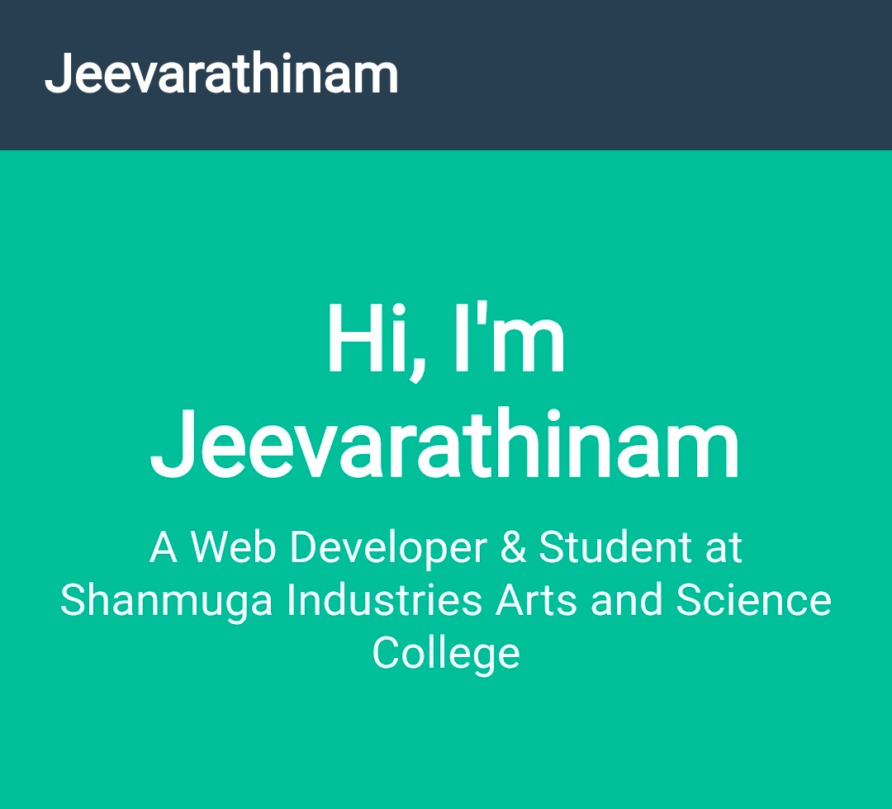

RESULTS AND SCREENSHOTS
3/21/2024 Annual Review
10

Slide 11
CONCLUSION
This portfolio website successfully serves its purpose of showcasing Jeevarathinam’s identity, skills, and projects in a professional and accessible format. It demonstrates a solid understanding of HTML, CSS, and basic JavaScript, making it a strong foundation for future additions such as blogs, downloadable resumes, or contact forms.
11

Slide 12
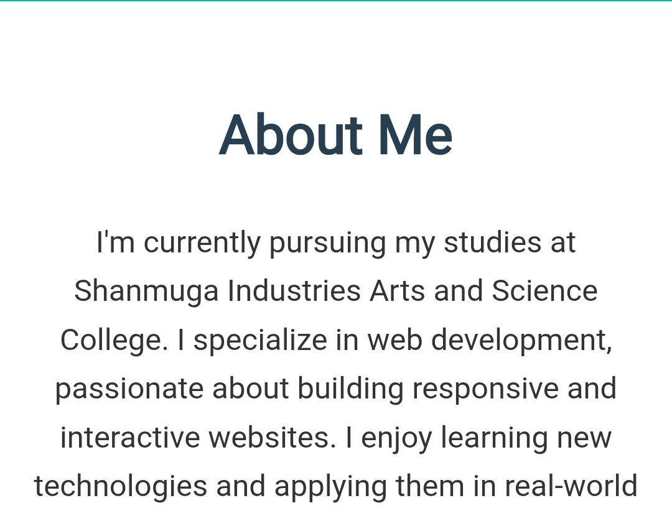
RESULTS AND SCREENSHOTS

Slide 13
RESULTS AND SCREENSHOTS

Slide 14
RESULTS AND SCREENSHOTS

Slide 15
RESULTS AND SCREENSHOTS

